Slide 1

Machine Learning for Engineers: Decision Trees (DT)
Mina Farmanbar
Associate Professor, University of Stavanger
for engineers

Slide 2
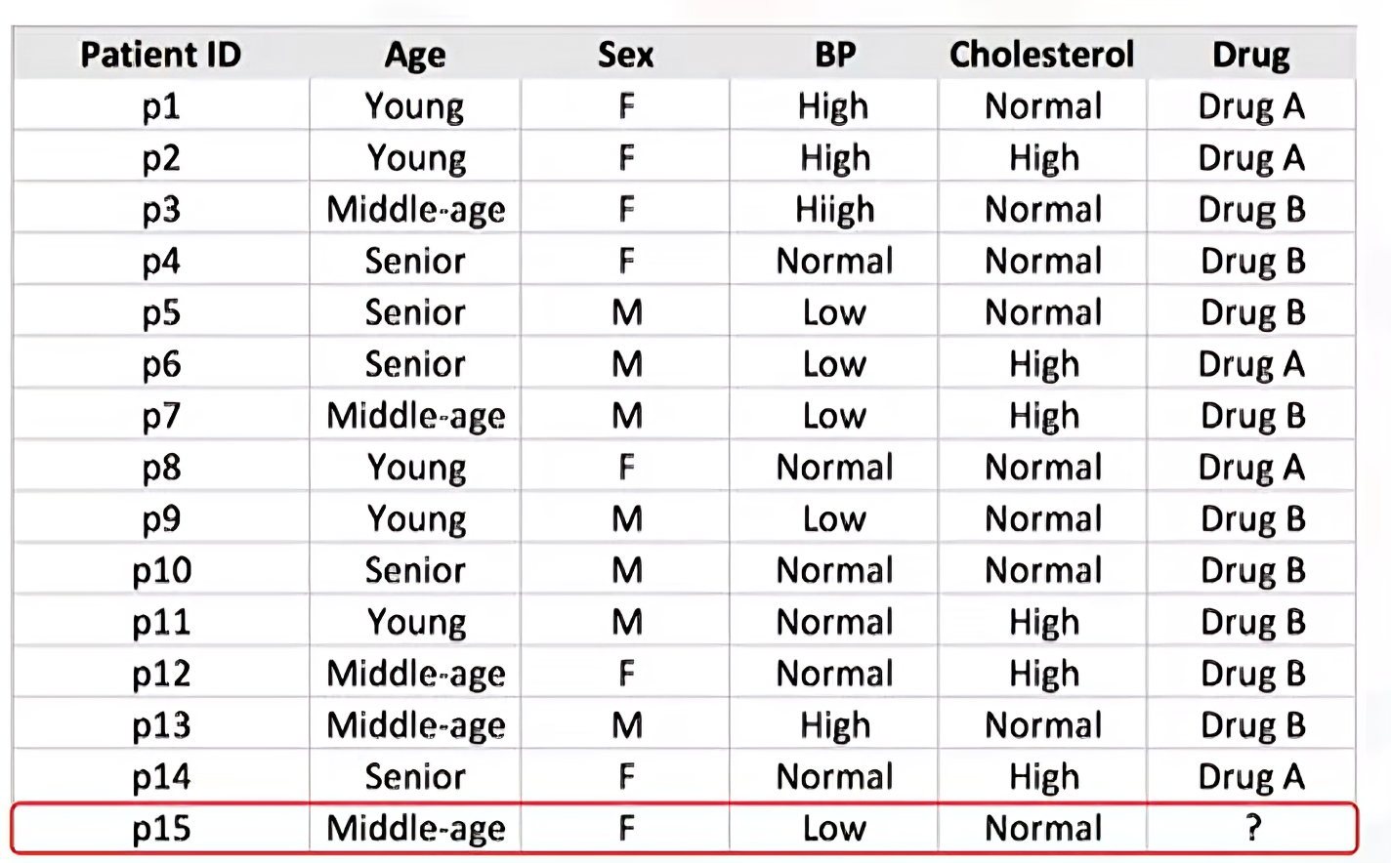
Decision Tree

Slide 3
Decision Tree

Slide 4
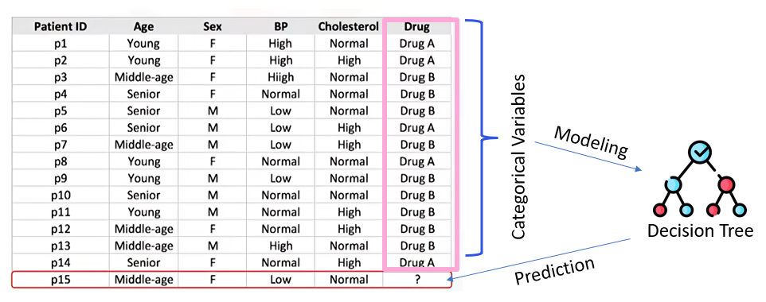
Decision Tree

Slide 5
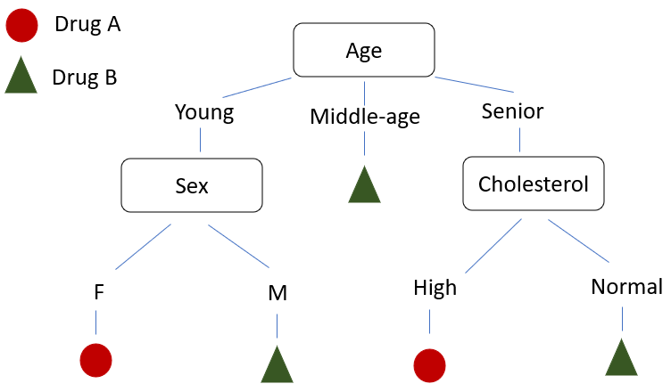
Classification using Decision Tree

Slide 6
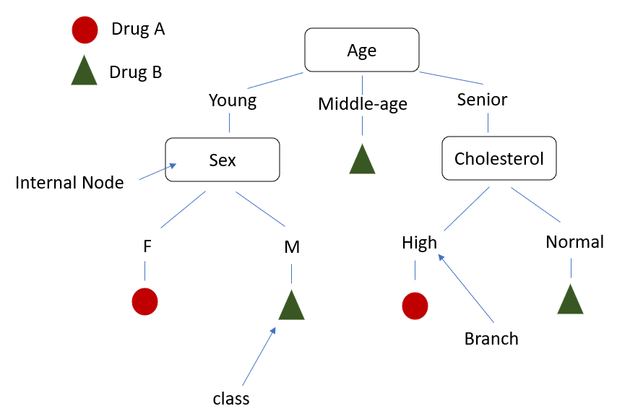
Classification using Decision Tree
Decision trees are about testing an attribute and branching the cases based on the result of the test.
Each internal node corresponds to a test, and each branch corresponds to a result of the test, and each leaf node assigns a patient to a class.

Slide 7
How can we build Decision Tree
A decision tree can be constructed by considering the attributes one by one.
1. Choose an attribute from dataset.
2. Calculate the significance of the attribute in the splitting of the data.
3. Split the data based on the value of the best attribute
4. Go to Step 1. (go to each branch and repeat it for the rest of the attributes)

Slide 8
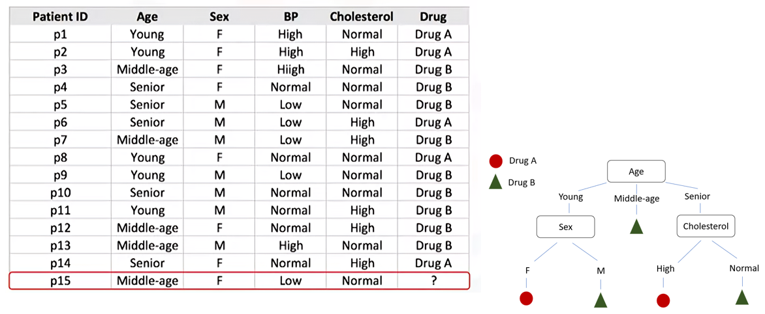
Decision Tree

Slide 9
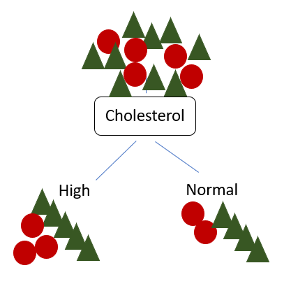
Which attribute is the best?

Slide 10
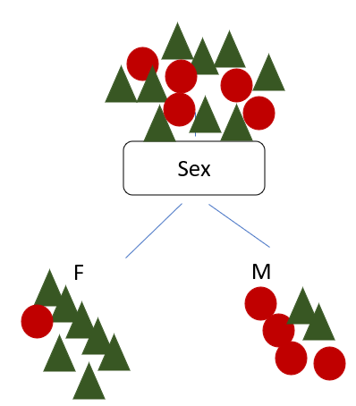
Which attribute is the best?

Slide 11
Decision Tree
We're looking for the best feature to decrease the impurity of patients in the leaves, after splitting them up based on that feature.
So, the sex feature is a good candidate in the following case because it almost found the pure patients.

Slide 12
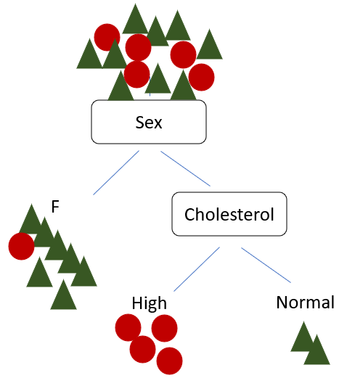
Decision Tree
More Predictiveness
Less Impurity
Lower Entropy

Slide 13
What attribute is the best?
As you might notice, the choice of attribute to split data is very important and it is all about purity of the leaves after the split.
A node in the tree is considered pure if in 100 percent of the cases, the nodes fall into a specific category of the target field.

Slide 14
What attribute is the best?
In fact, the method uses recursive partitioning to split the training records into segments by minimizing the impurity at each step.
Impurity of nodes is calculated by entropy of data in the node.

Slide 15
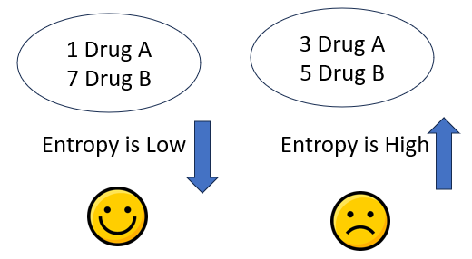
What is Entropy?
Measure of randomness or uncertainty
It is calculated for each node to assess how much uncertainty exists there.
*** the goal is to create trees where nodes have the lowest possible entropy, indicating more organized and predictive data distributions.

Slide 16
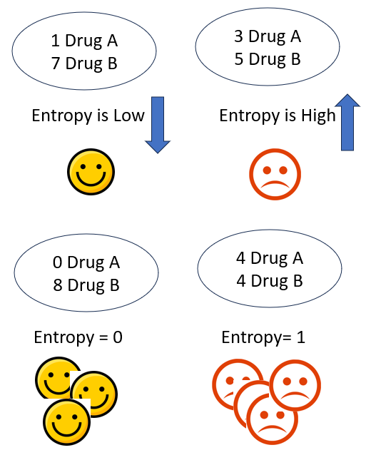
What is Entropy?
The entropy is used to calculate the homogeneity of the samples in that node.
If the samples are completely homogeneous, the entropy is zero and if the samples are equally divided it has an entropy of one.

Slide 17
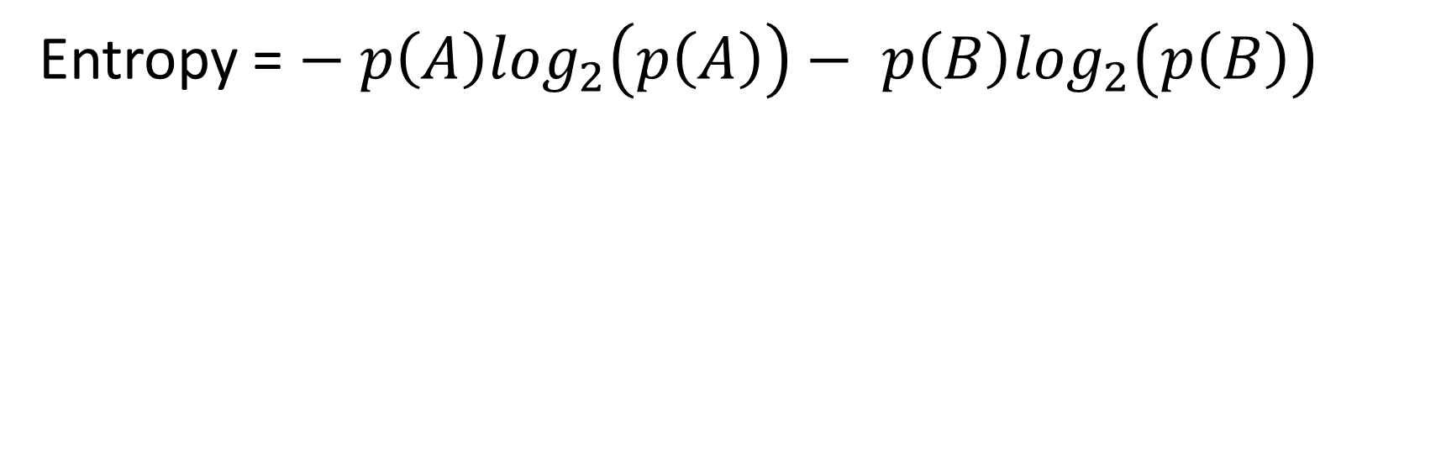

How to calculate Entropy?
You can easily calculate the entropy of a node using the frequency table of the attribute through the entropy formula where P is for the proportion or ratio of a category, such as drug $A or B$.
Entropy = $− p\left(A\right)\log_{2}\left(p\left(A\right)\right)− p\left(B\right)\log_{2}\left(p\left(B\right)\right)$

Slide 18
Calculate Entropy before splitting
There are 9 Drug B and 5 Drug A, We calculate the impurity of the target attribute >>> E = -(9/14)log(9/14) - (5/14)log(5/14) = 0.940

Slide 19
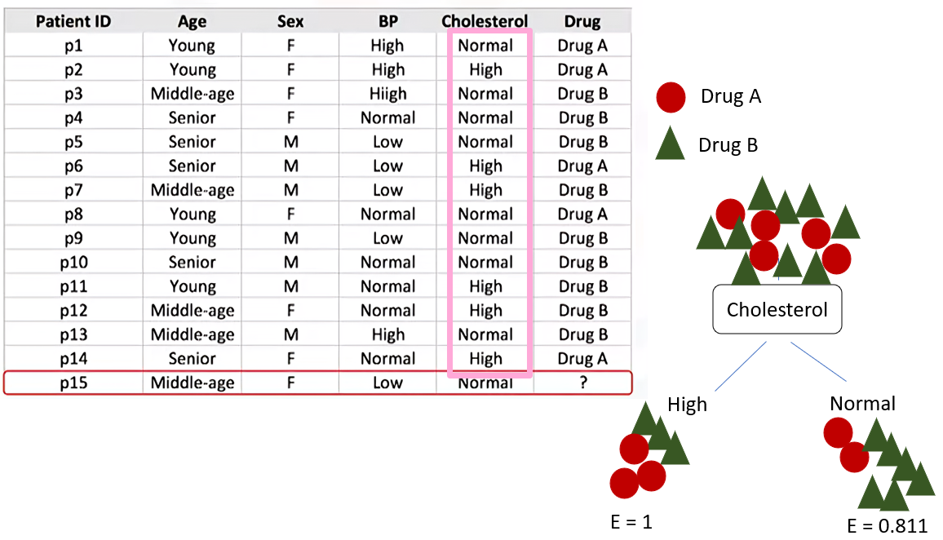
Calculate Entropy after splitting

Slide 20
Decision Tree
We should go through all the attributes and calculate the entropy after the split and then choose the best attribute.

Slide 21
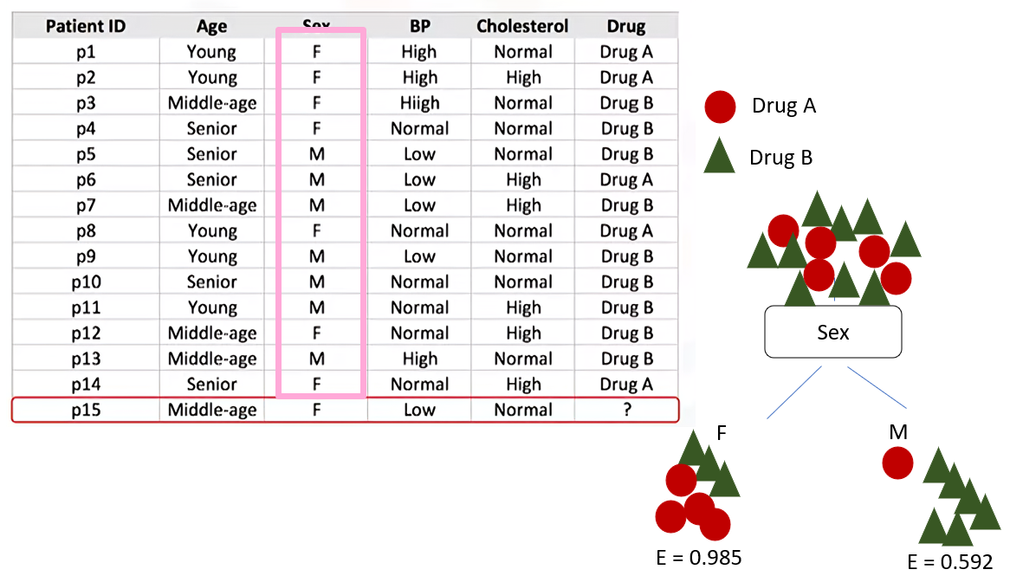
Calculate Entropy after splitting

Slide 22
Decision Tree
Now, the question is between the cholesterol and sex attributes which one is a better choice?
Which one is better as the first attribute to divide the dataset into two branches?

Slide 23
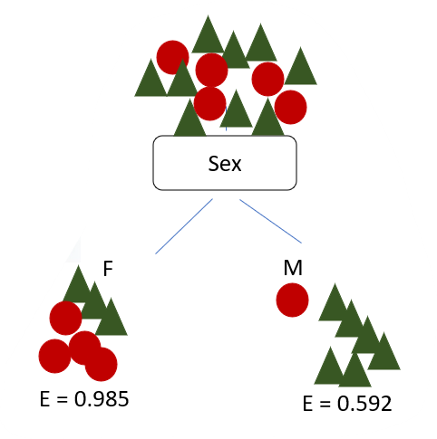
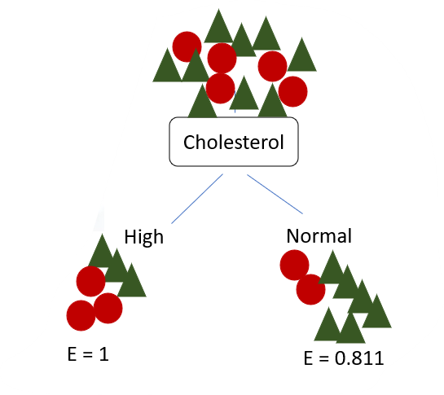
Calculate Entropy after splitting
The tree with the higher information gain after splitting.

Slide 24
Information Gain
is the information that can increase the level of certainty after splitting.
Entropy before split
E = 0.940
Information Gain =
(Entropy before split) - (Weighted Entropy after split)
Entropy
Information Gain
Entropy after split

Slide 25
Information gain of the tree if we use the sex attribute to split the data
Entropy before split
E = 0.940
Information Gain (sex) = (Entropy before split) - (Weighted Entropy after split)
(Entropy before split) = 0.940
(Weighted Entropy after split) = 7/14*0.985 + 7/14*0.592 = 0.151

Slide 26
Information gain of the tree if we use the Cholesterol attribute to split the data
Entropy before split
E = 0.940
Information Gain (sex) = (Entropy before split) - (Weighted Entropy after split)
(Entropy before split) = 0.940
(Weighted Entropy after split) = 6/14*1 + 8/14*0.811 = 0.048

Slide 27
Which attribute is more suitable?
Entropy before split
E = 0.940
Entropy before split
E = 0.940
Information Gain (Cholesterol) = 0.048
Information Gain (sex) = 0.151

Slide 28
Decision Tree
Now, what is the next attribute after branching by the sex attribute?
we should repeat the process for each branch and test each of
the other attributes to continue to reach the purest leaves.
This is the way you build a decision tree!!

Slide 29
Thank you
Mina Farmanbar
mina.farmanbar@uis.no

